Slide 1
Stress Orientation Rotation of the 2018 Mw 7.5 Palu Earthquake

Slide 2
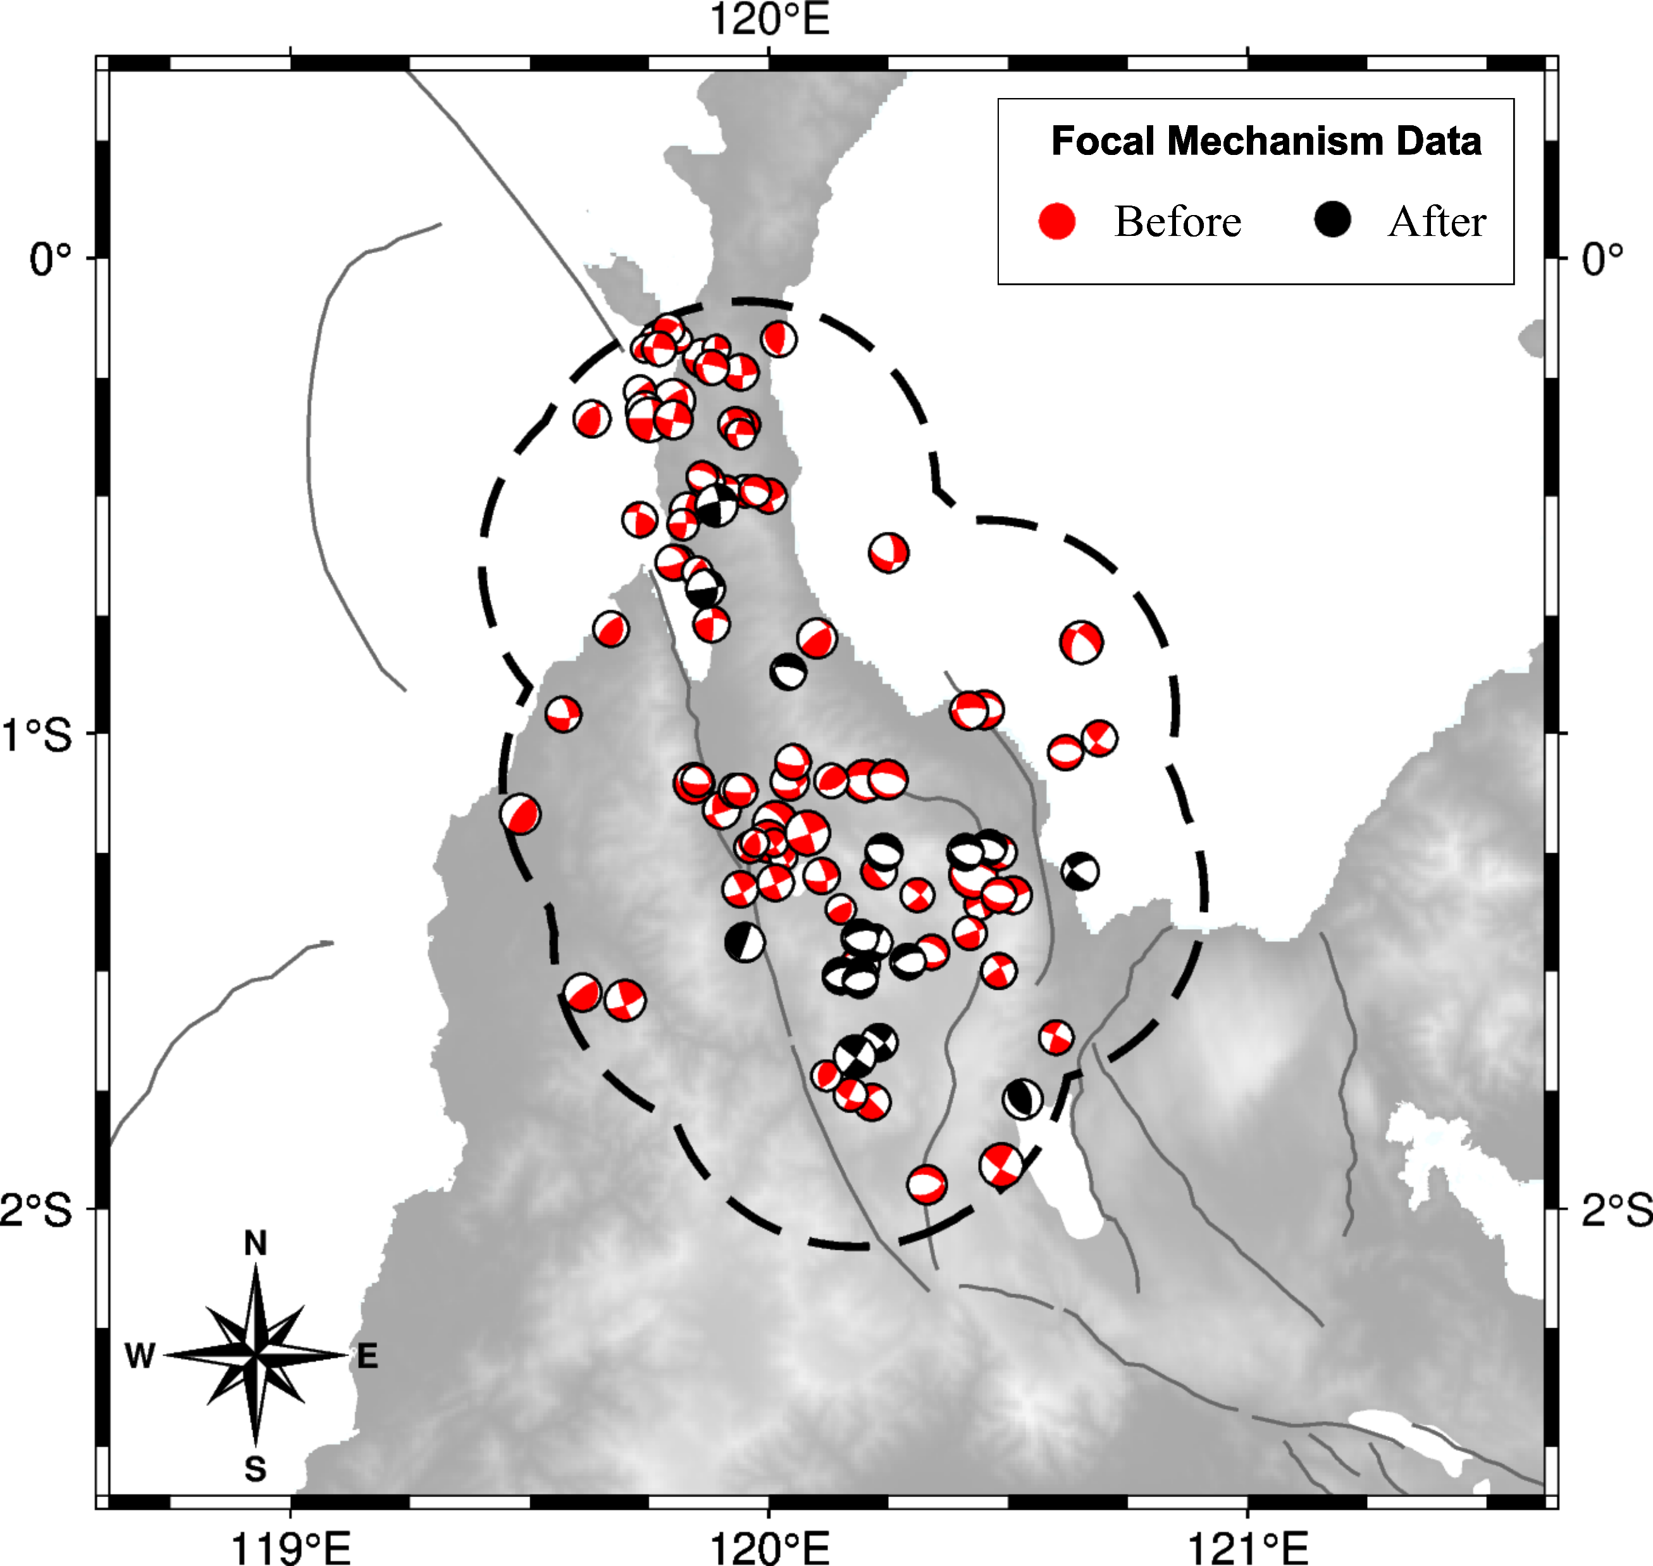
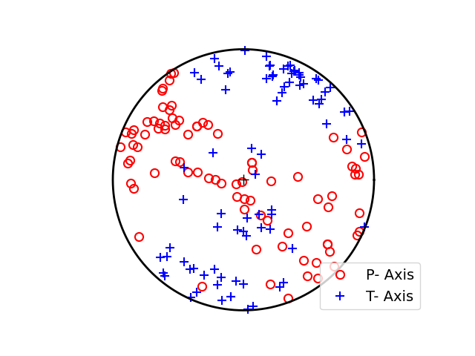
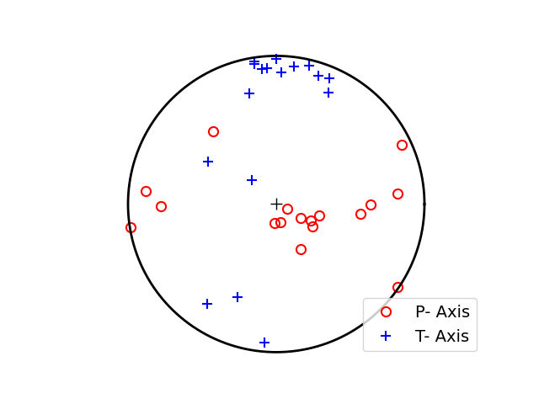
Focal Mechanisms Data
Before 2018 Mw7.5 Palu
85 events
May 1977 – Sep 2018
After 2018 Mw7.5 Palu
17 events
Sep 2018 – Nov 2021

Slide 3
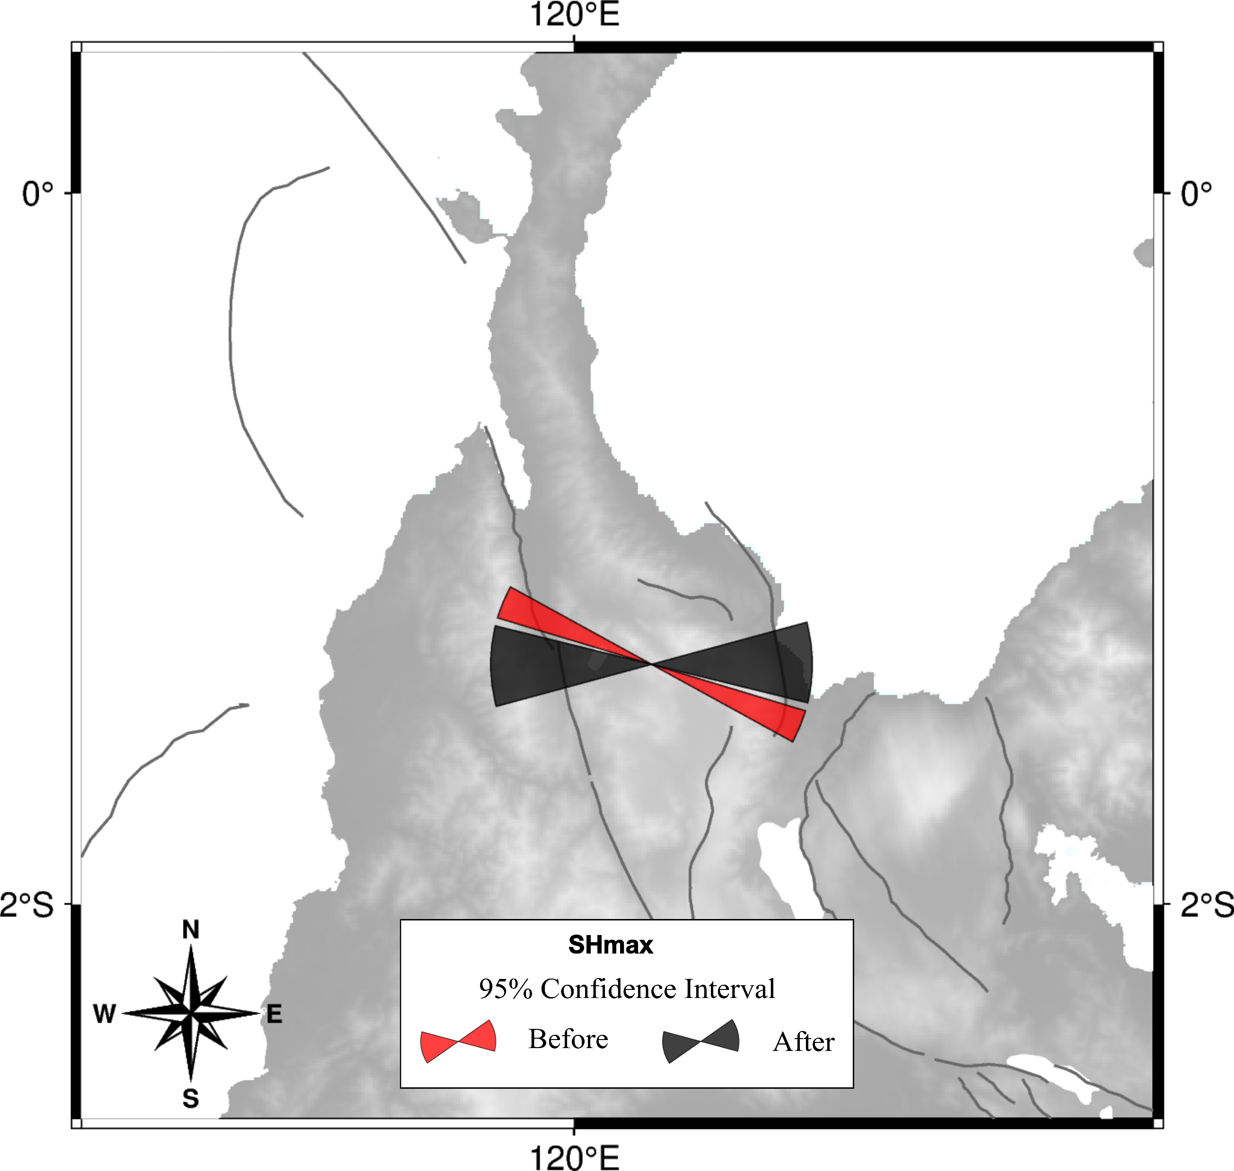
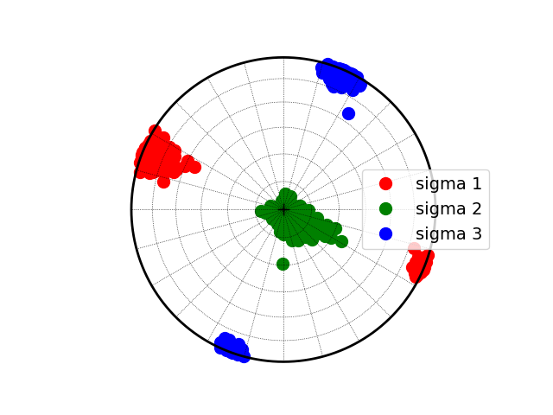
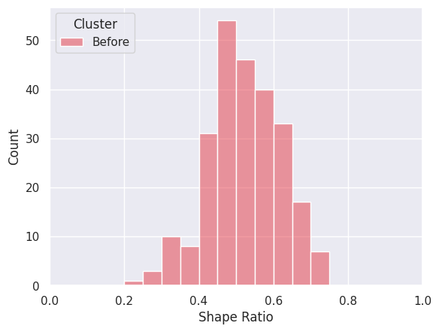
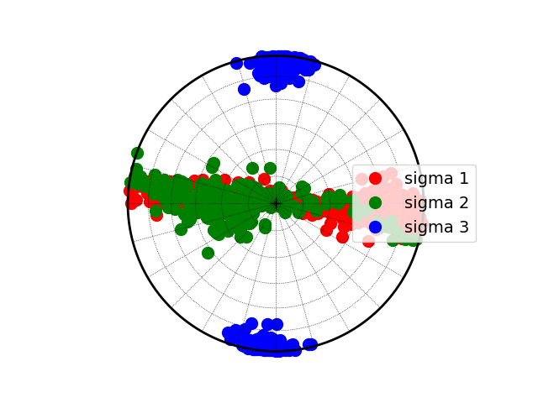
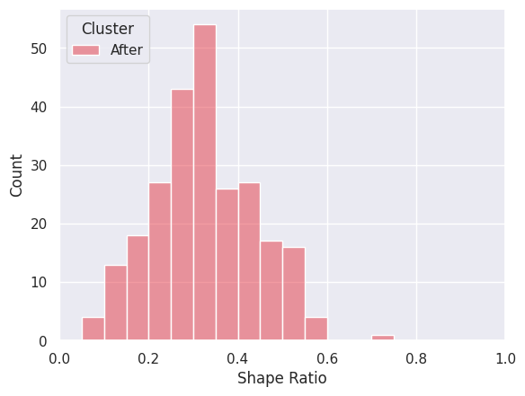
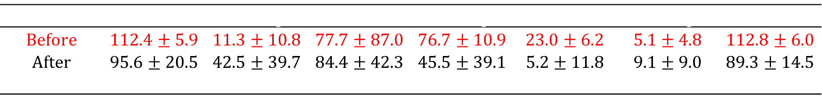
Stress Inversion Result
Before 2018 Mw7.5 Palu
After 2018 Mw7.5 Palu
 | $$σ1 Azimuth$$ | $$σ1 Plunge$$ | $$σ2 Azimuth$$ | $$σ2 Plunge$$ | $$σ3 Azimuth$$ | $$σ3 Plunge$$ | SHmax
Before | 112.4 ± 5.9 | 11.3 ± 10.8 | 77.7 ± 87.0 | 76.7 ± 10.9 | 23.0 ± 6.2 | 5.1 ± 4.8 | 112.8 ± 6.0
After | 95.6 ± 20.5 | 42.5 ± 39.7 | 84.4 ± 42.3 | 45.5 ± 39.1 | 5.2 ± 11.8 | 9.1 ± 9.0 | 89.3 ± 14.5
$$Δ$$ | -16.7 ± 20.3 | 32.7 ± 42.6 | 7.5 ± 99.6 | -32.4 ± 42.0 | -17.1 ± 14.6 | 2.9 ± 10.5 | -22.8 ± 15.4

Slide 4

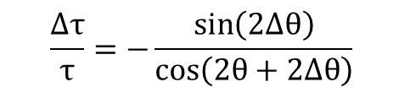
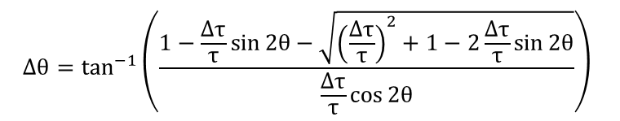
Stress Drop Ratio $\left(\frac{Δτ}{τ}\right)$ Calculation
To calculate the stress drop ratio, we use equation (4) in Hardebeck 2001
$$Δθ=\tan^{−1}\left(\frac{1−\frac{Δτ}{τ}\sin{2θ}−\sqrt{{\left(\frac{Δτ}{τ}\right)}^{2}+1−2\frac{Δτ}{τ}\sin{2θ}}}{\frac{Δτ}{τ}\cos{2θ}}\right)$$
$$\frac{Δτ}{τ}=−\frac{\sin\left(2Δθ\right)}{\cos\left(2θ+2Δθ\right)}$$

Slide 5
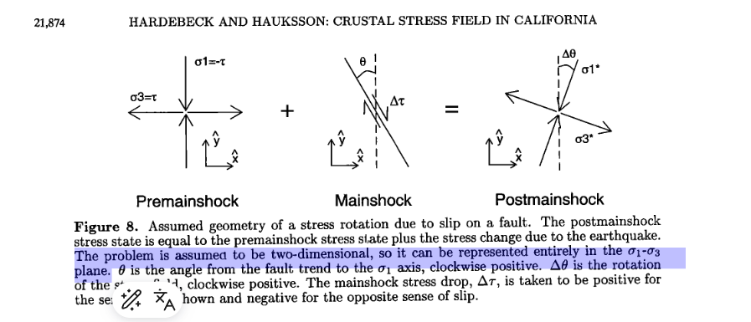
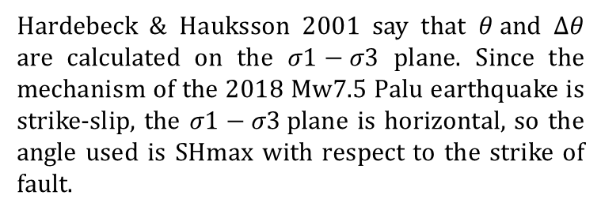

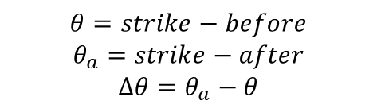

Calculation of $θ and Δθ$
Hardebeck & Hauksson 2001 say that $θ and Δθ$ are calculated on the $σ1−σ3$ plane. Since the mechanism of the 2018 Mw7.5 Palu earthquake is strike-slip, the $σ1−σ3$plane is horizontal, so the angle used is SHmax with respect to the strike of fault.
U
Nodal plane 2018 Mw 7.5 Palu
348$∙$57$∙$-15 87$∙$77$∙$-146
$$θ=strike−before$$
$$θ_{a}=strike−after$$
$$Δθ=θ_{a}−θ$$
$$Fault | Before | After | θ+Δθ | θ | Δθ$$
S

Slide 6
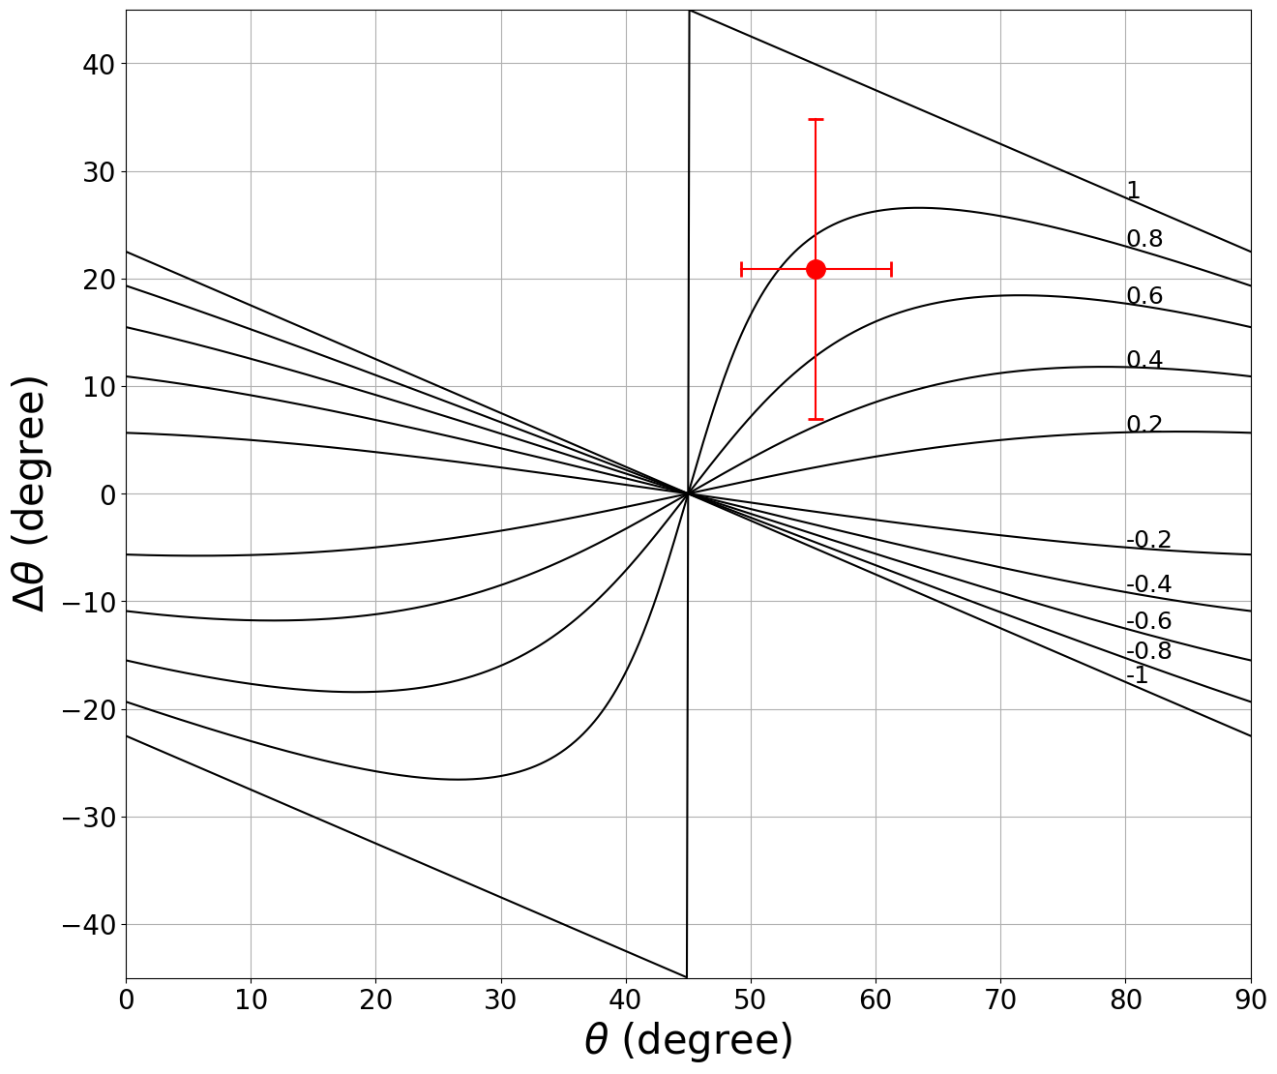
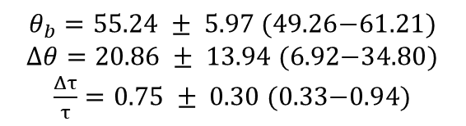
Model Stress Drop 2018 Mw 7.5 Palu by SHmax
$θ_{b}=\text{55.24 }±\text{ 5.97 (49.26−61.21)}$
$Δθ=\text{20.86 }±\text{ 13.94 (6.92−34.80}\text{)}$
$\frac{Δτ}{τ}=\text{0.75 }±\text{ 0.30 (0.33−0.94)}$

